Slide 1
Team
M.Prathiba
M.Varshitha
M.Mounika
A.Varshitha
C.Kavya
S.Sameerulla

Slide 2
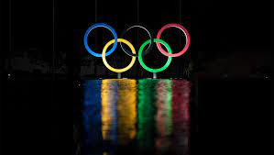
Short term internship
Data-Driven insights on olympics sports participation and performance

Slide 3
project flow
Data preparation
Data visualization
Dash board
Story
Report
performance testing
Web integration

Slide 4
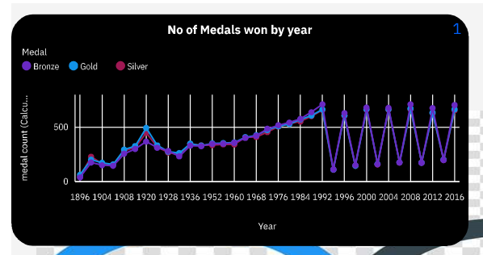
Data visualizations
The line chart is about No.of medals won by year.
The x-axis contains year.
The y-axis contains medal count which we calculated using count function.
The colour contains the medal.
violet colour is bronze and skyblue is gold and red is silver medals won in different years.

Slide 5
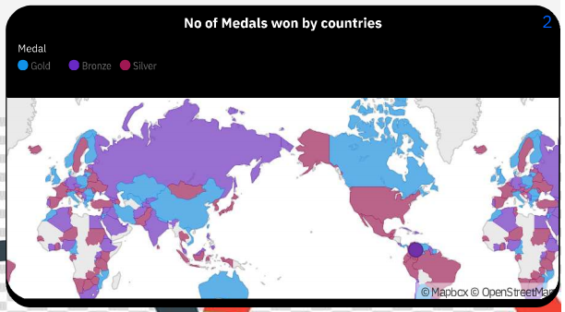
This map contains No.of medals won by different countries.
Location contains region,location color contains medal and tool kit contains medal count.
And that medal contains only the Gold,silver,bronze do not contain NA values.
skyblue colour represents gold,violet colour represents bronze and red colour represents silver medals.

Slide 6
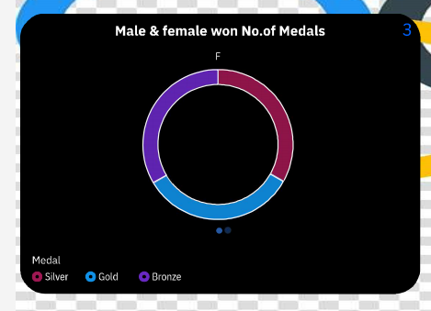
This pie chart represents the no of medals won by both males and females from different years.
This contains segments i.e medal size contains medal count and repeat contains sex which is column.
skyblue colour represents gold,violet colour represents bronze and red colour represents silver medals.

Slide 7
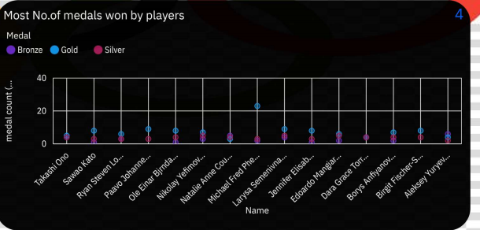
This scatterplot represents most no of medals won by players.
In this x-axis contains name y-axis contains medal count and color contains medal only(gold,silver,bronze).
skyblue colour represents gold,violet colour represents bronze and red colour represents silver medals.

Slide 8
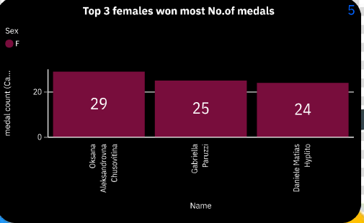
This column contains most no of medals won by top 3 females.
In this bars contains name length contains medal count and finally color contains sex only females.
Oksana aleksandrovna chusovitina has highest no of medals i.e 29.
Daniele matias hyplito has lowest no of medals i.e 24.

Slide 9
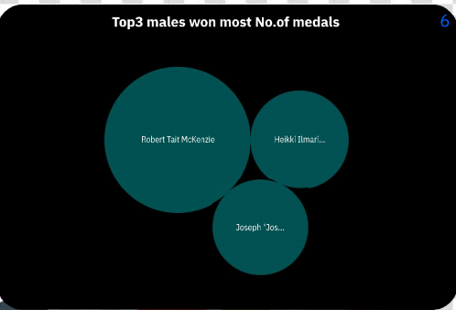
This packed bubble represents the most no of medals won by top3 males.
In this bubbles contains names size contains medal count and color contains sex only males.
In this robert tait mckenzio got highest medals among 3 males.
Remaining both are same.

Slide 10
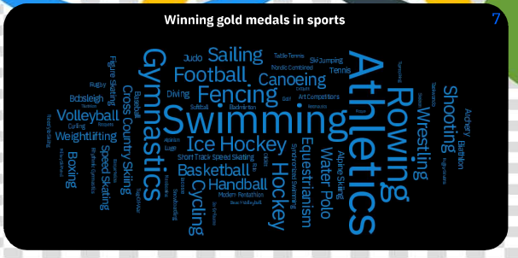
This word cloud represents winning gold medals in sports.
In this words contains sports color contains medal only gold and size contains medal count.
Some of the sports like swimming,basketball,boxing etc.
Hockey got highest no of gold medals among all sports.

Slide 11
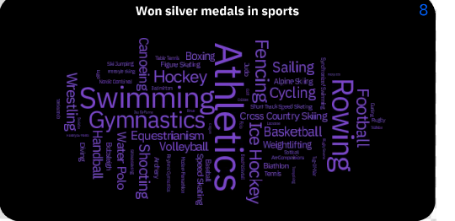
This word cloud contains winning silver medals in sports.
In this words contains sports color contains medals (silver) and size medal count.
It contains sports like swimming,basketball,boxing etc.
Alexander Dityatin won highest no of silver medals in gymnastics.

Slide 12
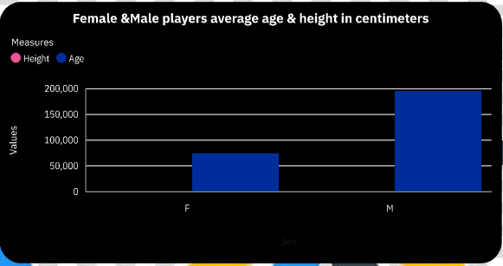
This column chart represents the average age & height in centimeters.
In this length contains height,age and bars contains sex.
pink color represents height and blue color represents age.
In this we calculate the average for age and height.

Slide 13
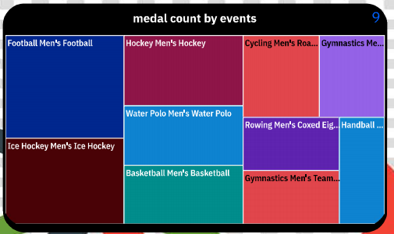
This tree map represents the medal count by events.
In this Area hierarchy contains events and size contains medal count.
How many medals got by each sport and moreover gymnastics got highest medal among all the sports.

Slide 14
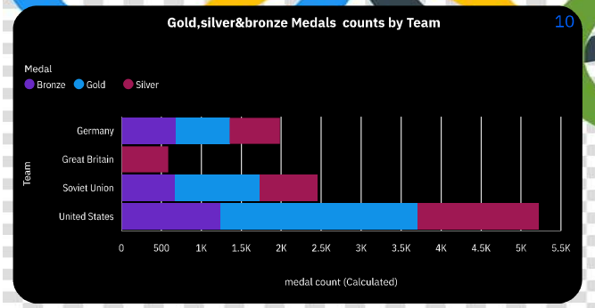
This barchart represents the gold,silver,bronze medals counts by team.
In this the bars contains team and length contains medal count.
skyblue colour represents gold,violet colour represents bronze and red colour represents silver medals in different countries.

Slide 15
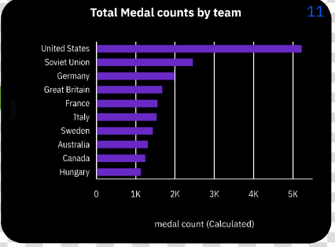
This bar chart contains total medals counts by team.
In this the bars contains team and length contains medal count.
The highest country is united states with medal count 5k.
The lowest country is hungry states with medal count 1k.

Slide 16
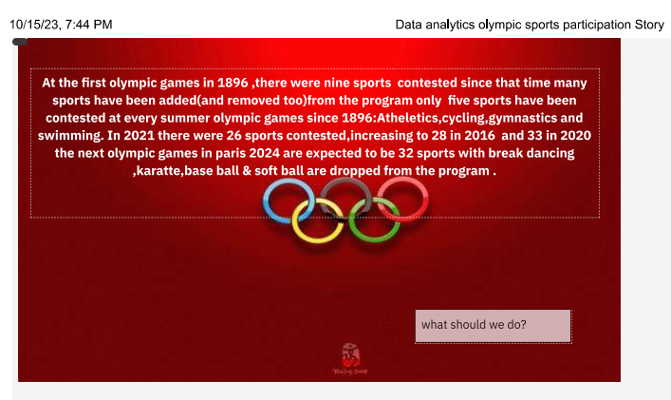
Story

Slide 17
Most olympic medals won by females and males athletes
This pie chart represents the no of medals won by both males and females from different years.
This contains segments i.e medal size contains medal count and repeat contains sex which is column.
skyblue colour represents gold,violet colour represents bronze and red colour represents silver medals.

Slide 18
Total medals counts by team
This bar chart contains total medals counts by team.
In this the bars contains team and length contains medal count.
The highest country is united states with medal count 5k.
The lowest country is hungry states with medal count 1k.

Slide 19
Won silver medals in sports
This word cloud contains winning silver medals in sports.
In this words contains sports color contains medals (silver) and size medal count.
It contains sports like swimming,basketball,boxing etc.
Alexander Dityatin won highest no of silver medals in gymnastics.

Slide 20
Most no.of medals won by players
This scatterplot represents most no of medals won by players.
In this x-axis contains name y-axis contains medal count and color contains medal only(gold,silver,bronze).
skyblue colour represents gold,violet colour represents bronze and red colour represents silver medals.

Slide 21
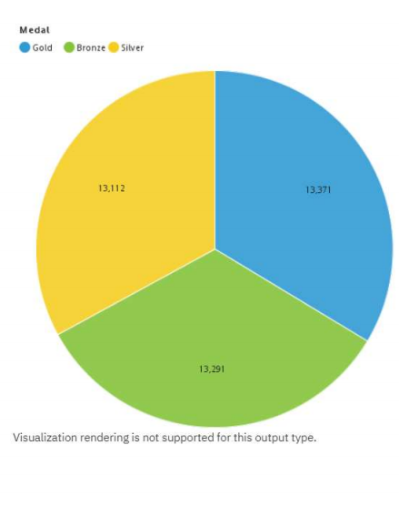
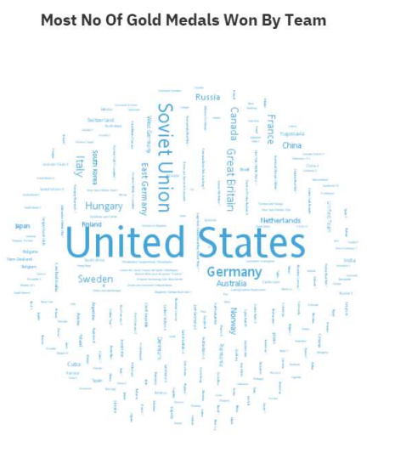
Report

Slide 22
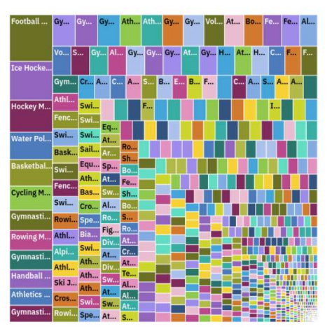
Most no.of medal counts by events

Slide 23
Web integretion link
http://127.0.0.1:8000

Slide 24
Dashboard link
https://us3.ca.analytics.ibm.com/bi/?perspective=dashboard&amp;pathRef=.my_folders%2FOlympic%2Bdashboard&amp;closeWindowOnLastView=true&amp;ui_appbar=false&amp;ui_navbar=false&amp;shareMode=embedded&amp;action=view&amp;mode=dashboard&amp;subView=model00000

Slide 25
Story link
<iframe src="https://us3.ca.analytics.ibm.com/bi/?perspective=story&amp;pathRef=.my_folders%2FOlympic%2Bstoy&amp;closeWindowOnLastView=true&amp;ui_appbar=false&amp;ui_navbar=false&amp;shareMode=embedded&amp;action=view&amp;sceneId=model0000018b2ca856b9_000

Slide 26
Report link
<iframe src="https://us3.ca.analytics.ibm.com/bi/?pathRef=.my_folders%2FOlympic%2BSports%2Breport&amp;closeWindowOnLastView=true&amp;ui_appbar=false&amp;ui_navbar=false&amp;shareMode=embedded&amp;action=run&amp;format=HTML&amp;prompt=false" width="1350" he

Slide 27
Students details
Sree vidyanikethan degree college(Affilicated to sv university)
1.Name: M.prathiba 2.Name: M.varshitha
Hall ticket no: 032202214 Hall ticket no:0322022110
Admin no: BSCMSCS2021005 Admin no:BSCMSCS2021012
email.id: prathiba9346258177@gmail.com email.id:varshithamannem77@gmail.com
3. Name: M.mounika 4. Name: A.varshitha
Hall ticket no:0322022108 Hall ticket no:0322022075
Admin no:BSCMSCS2021024 Admin no: BSCMSCS2021020
email.id:mounikamallela67@gmail.com email.id :ramadasuramadasu123@gmail.com

Slide 28
5. Name : C.kavya 6. Name : S.sameerulla
Hall ticket no : 0322022086 Hall ticket no :0322022135
Admin no:BSCMSCS2021004 Admin no : BSCMSCS2021018
email id:ckavya6171@gmail.com email id: shaiksameerulla9@gmail.com

Slide 29


